Slide 1









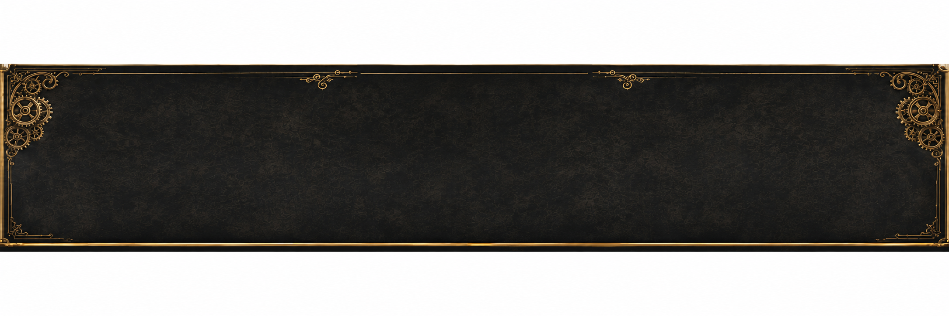
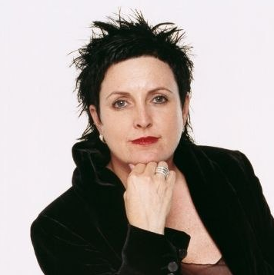
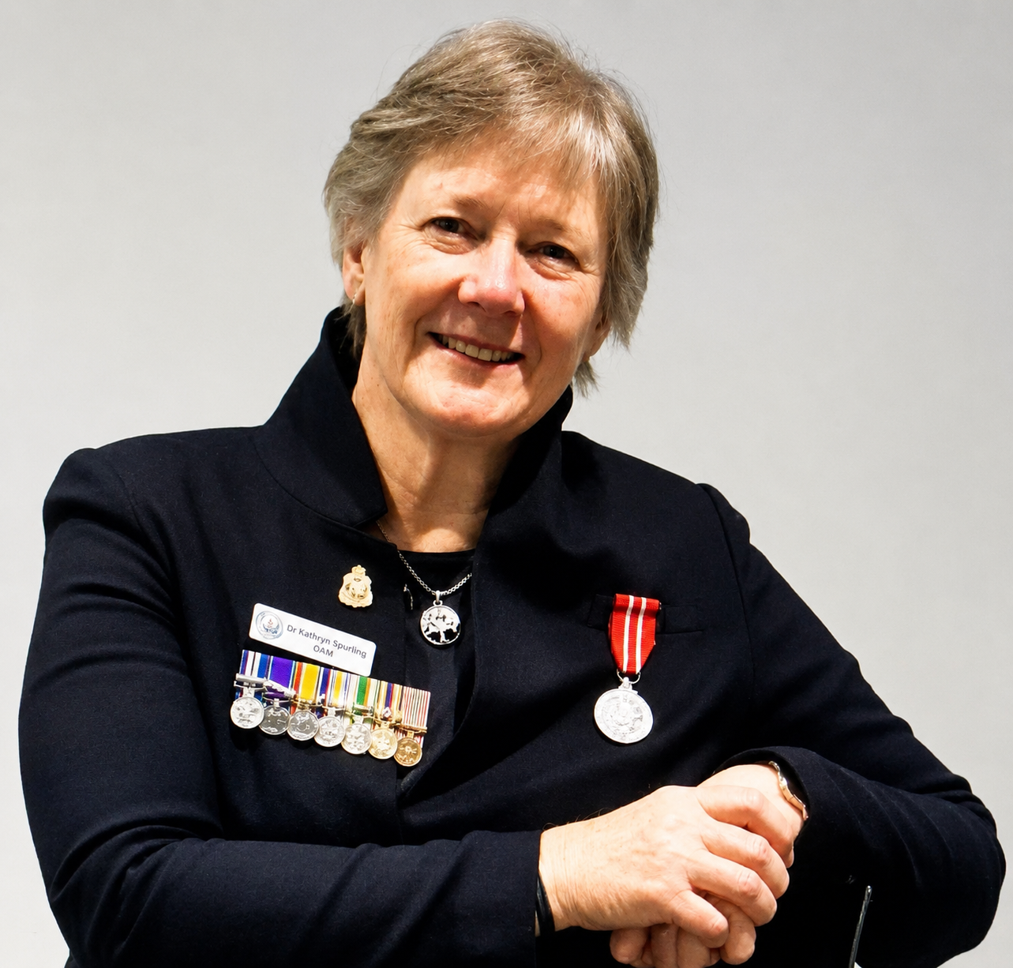
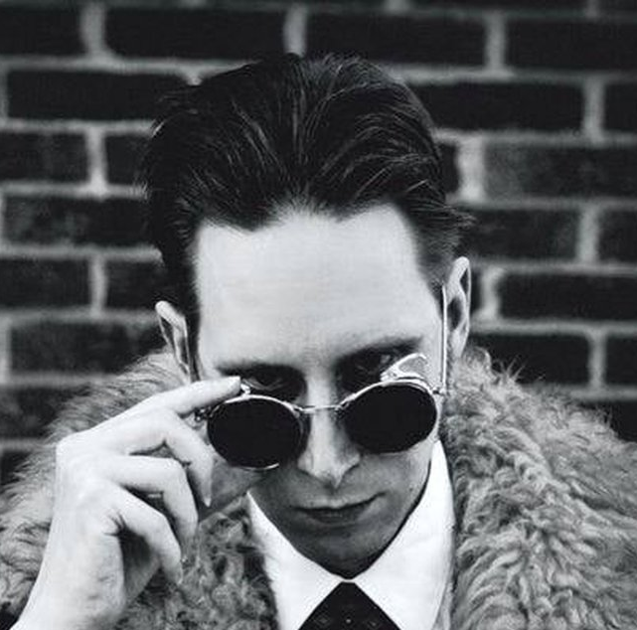
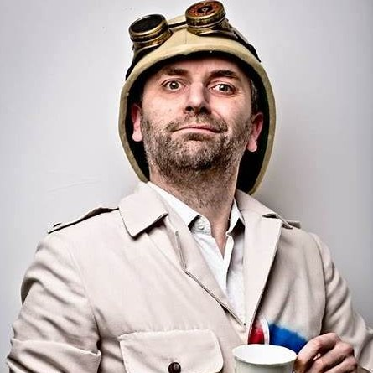


STEAMPUNK.AU
THE INTERNATIONAL STEAMPUNK ART PRIZE
GOES GLOBAL
FROM EVERYWHERE
FOR EVERYWHERE
OPEN TO ARTISTS
WORLDWIDE
All ART FORMS
WELCOME
AUD $2,000 IN PRIZES • FREE TO ENTER
OPEN TO ARTISTS AND MAKERS WORLDWIDE
PAINTING ⚙ DRAWING ⚙ SCULPTURE ⚙ PHOTOGRAPHY ⚙ DIGITAL ART ⚙ MIXED MEDIA ⚙ COSTUME DESIGN ⚙ & MORE
JUDGES' GRAND PRIZE
PLUS
Permanent featured artist page on Steampunk Australia
Interview on Steampunk Radio
2-month promotion across our website, Facebook page & radio
Artwork featured as the face of the 2027 competition
Professional digital winner’s seal
Inclusion in an online exhibition of finalists
PEOPLE’S CHOICE PRIZE
PLUS
Three-month Steampunk Radio promotional campaign.
Featured artist profile
The title World Steampunk People’s Choice Winner 2026
You can win both prizes
AUD $1,500 CASH
AUD $ 500 CASH
INTERNATIONAL STEAMPUNK
ARTIST OF THE YEAR 2026
WORLD STEAMPUNK
PEOPLE’S CHOICE WINNER 2026
MEET THE JUDGES
LISA McGUIGAN
DR KATHRYN SPURLING
G. D.FALKSEN
PROFESSOR ELEMENTAL
WHO CAN ENTER?
Open to artists worldwide of all skill levels. Artists and makers welcome. You keep the copyright.
KEY DATES
Entries Open: 11th July 2026
Final Entry Deadline: 30th November 2026
Winners Announced: 06 February 2027
HOW TO ENTER
Submit online at
www. steampunk.au/competition
REAL HUMANS. REAL JUDGING.
Judged by a panel of artists, makers and industry experts.
All entries welcome.
⚙ IMAGINE THE PAST. INVENT THE FUTURE. INSPIRE THE WORLD. ⚙

Slide 2


STEAMPUNK AUSTRALIA PRESENTS
THE INTERNET IS TELLING US
THE ART WORLD
IS BEING INVADED BY BOTS.
FROM EVERYWHERE
FOR EVERYWHERE
OPEN TO ARTISTS
WORLDWIDE
All ART FORMS
WELCOME
We’re opening the competition to the world
so human imagination can prove otherwise.
PAINTING ⚙ DRAWING ⚙ SCULPTURE ⚙ PHOTOGRAPHY ⚙ DIGITAL ART ⚙ MIXED MEDIA ⚙ COSTUME DESIGN ⚙ & MORE
JUDGES' GRAND PRIZE
PLUS
Permanent featured artist page on Steampunk Australia
Interview on Steampunk Radio
2-month promotion across our website, Facebook page & radio
Artwork featured as the face of the 2027 competition
Professional digital winner’s seal
Inclusion in an online exhibition of finalists
PEOPLE’S CHOICE PRIZE
PLUS
Three-month Steampunk Radio promotional campaign.
Featured artist profile
The title World Steampunk People’s Choice Winner 2026
You can win both prizes
AUD $1,500 CASH
AUD $ 500 CASH
INTERNATIONAL STEAMPUNK
ARTIST OF THE YEAR 2026
WORLD STEAMPUNK
PEOPLE’S CHOICE WINNER 2026
BEYOND THE PRIZES
TOP 20 FINALISTS FEATURED IN OUR ONLINE EXHIBITION
Every finalist will receive global exposure and a permanent gallery page.
WHO CAN ENTER?
Open to artists worldwide of all skill levels.
All art forms welcome.
You keep the copyright.
KEY DATES
Entries Open: 11th July 2026
Final Entry Deadline: 30th November 2026
Winners Announced: 06 February 2027
HOW TO ENTER
Submit online at
www. steampunk.au/competition
REAL HUMANS.
REAL JUDGING.
Judged by a panel of artists, makers and industry experts.
All entries welcome.
• High quality images or video
• Title, description & inspiration + Your artist statement
• Free to enter - Up to 3 entries welcome per artist
⚙ IMAGINE THE PAST. INVENT THE FUTURE. INSPIRE THE WORLD. ⚙
THE INTERNATIONAL
STEAMPUNK ART PRIZE 2026

Slide 3


NO AI ART
ALLOWED
NO OFFENCE
JUST PRINCIPLE

Slide 7
NO AI ART
ALLOWED
NO OFFENCE
JUST PRINCIPLE

Slide 9


