Slide 1
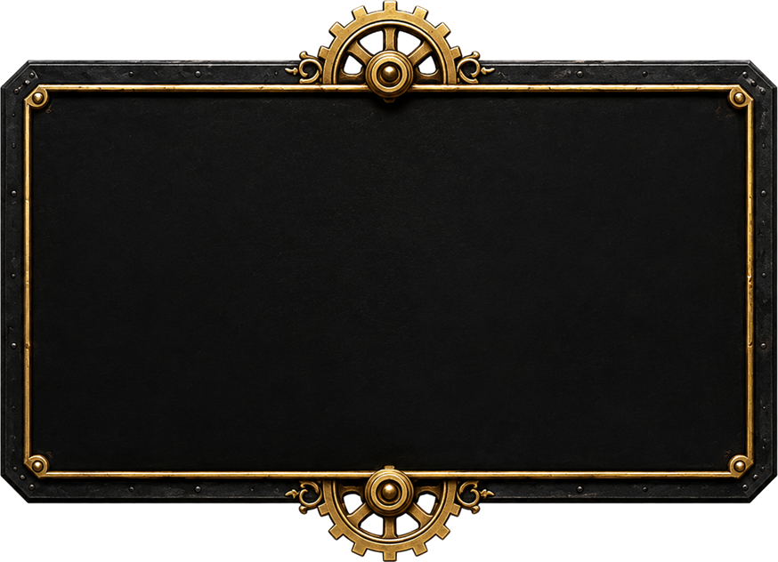

$1,500
JUDGES GRAND PRIZE
STEAMPUNK ART
COMPETITION

Slide 2


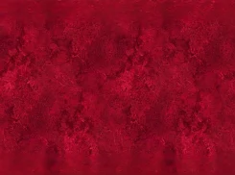

$2,000
CASH PRIZES
3 FREE ENTRIES
NO AI
OPEN WORLDWIDE

Slide 3
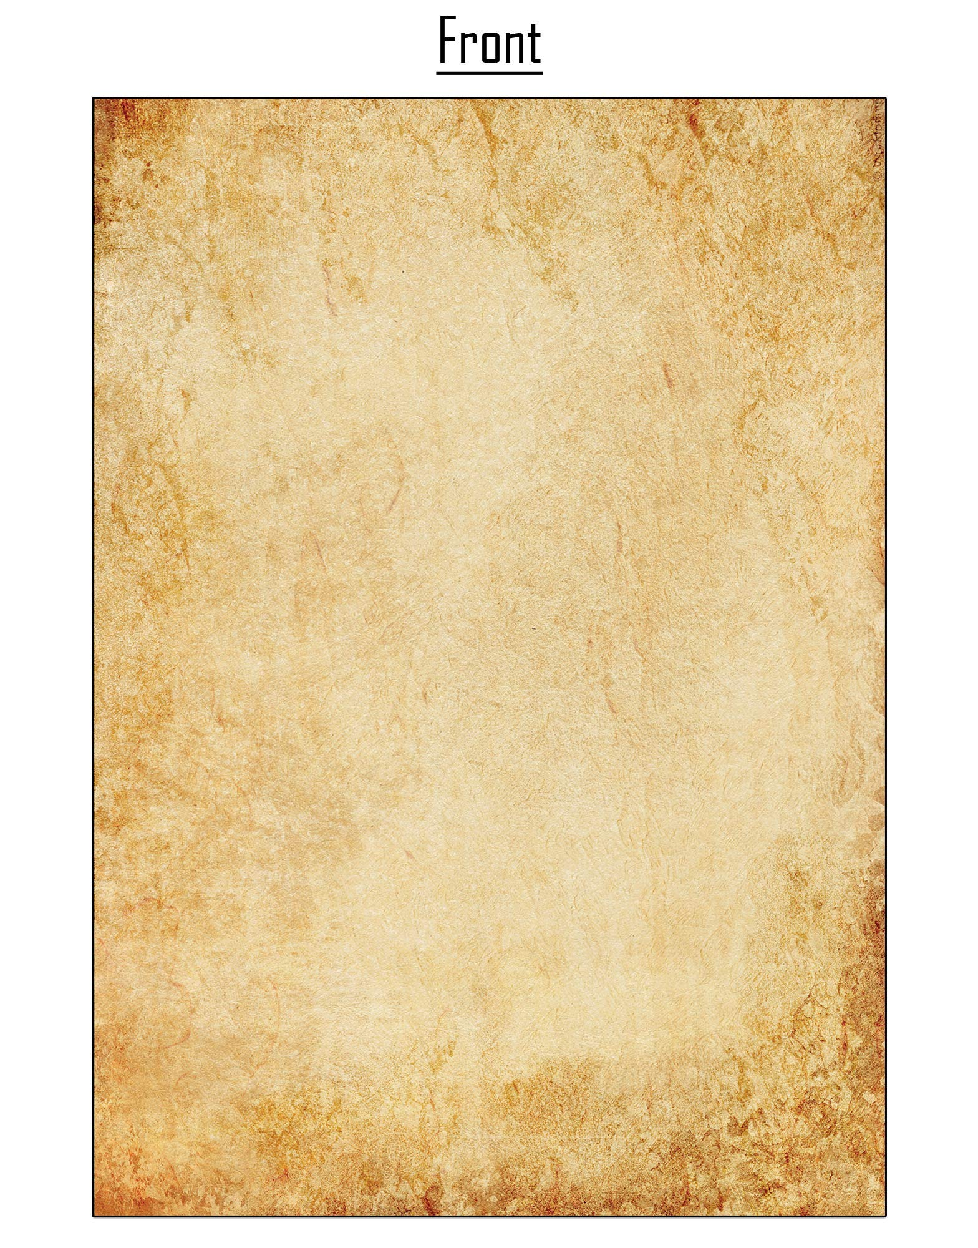

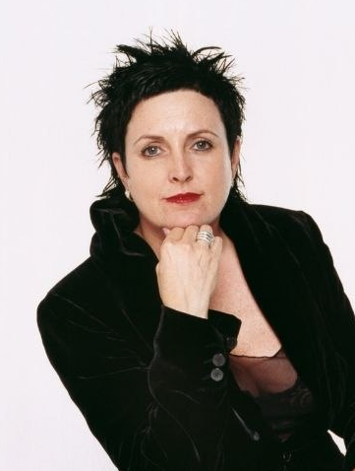
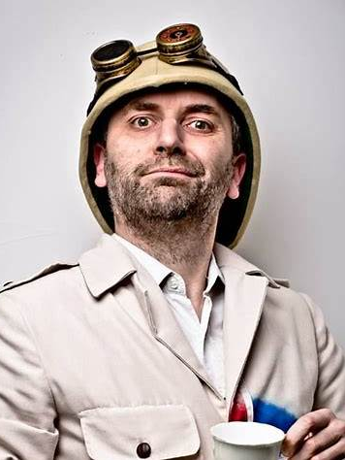
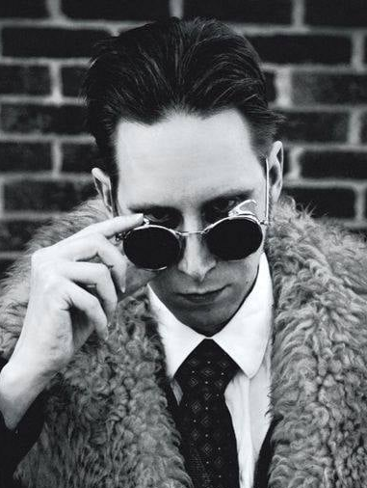
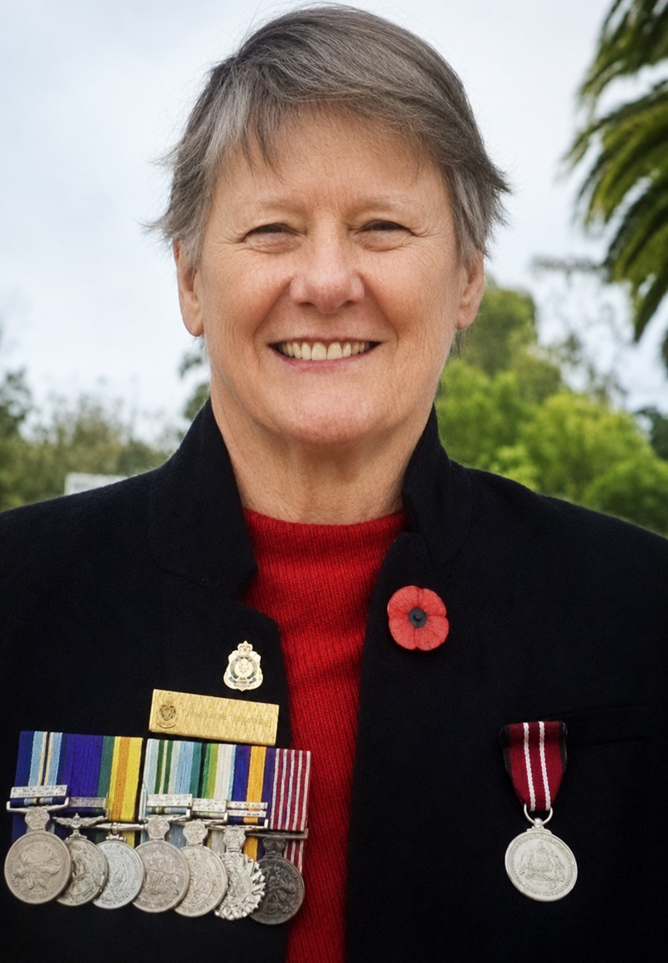
FOUR JUDGES.
ONE AMAZING OPPORTUNITY.
LISA MCGUIGAN
PROFESSOR ELEMENTAL
G.D. FALKSEN
DR KATHRYN SPURLING
STEAMPUNK ART COMPETITION

Slide 4


FOUR JUDGES.
Know an artist who should enter?
ONE AMAZING OPPORTUNITY.
TAG THEM!!!
LISA MCGUIGAN
PROFESSOR ELEMENTAL
G.D. FALKSEN
DR KATHRYN SPURLING
STEAMPUNK ART COMPETITION

Slide 5
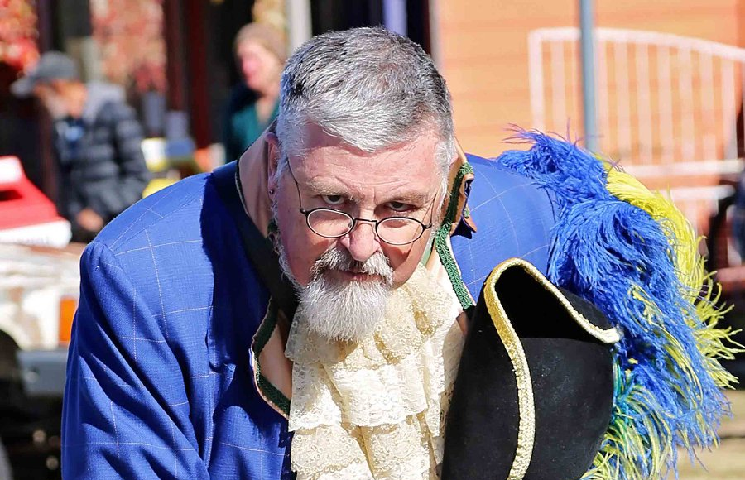
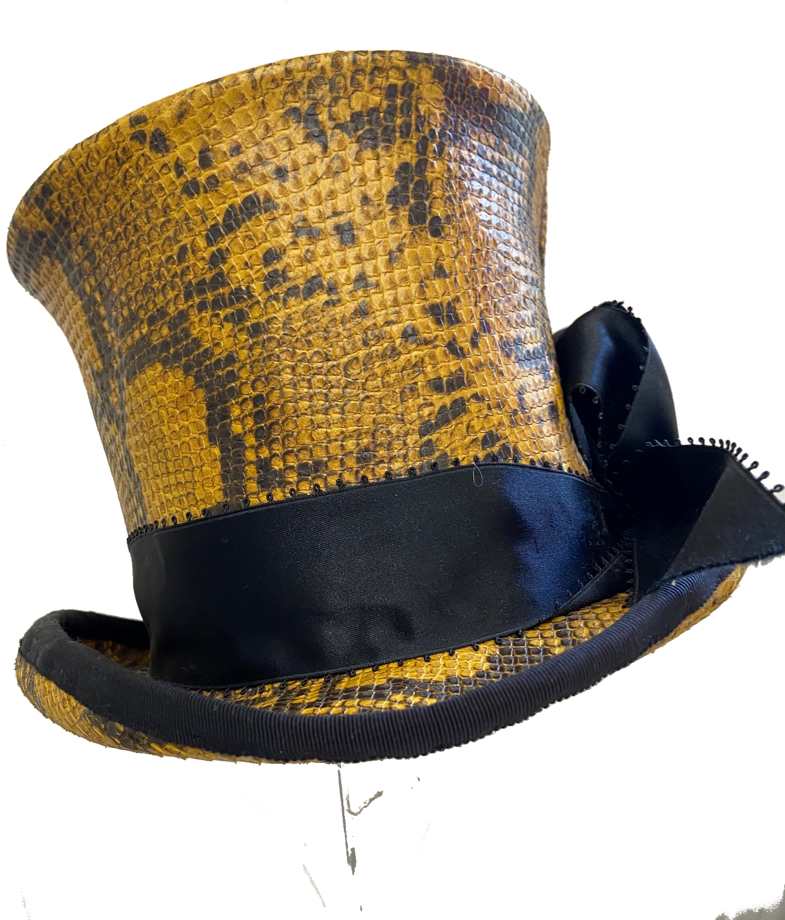

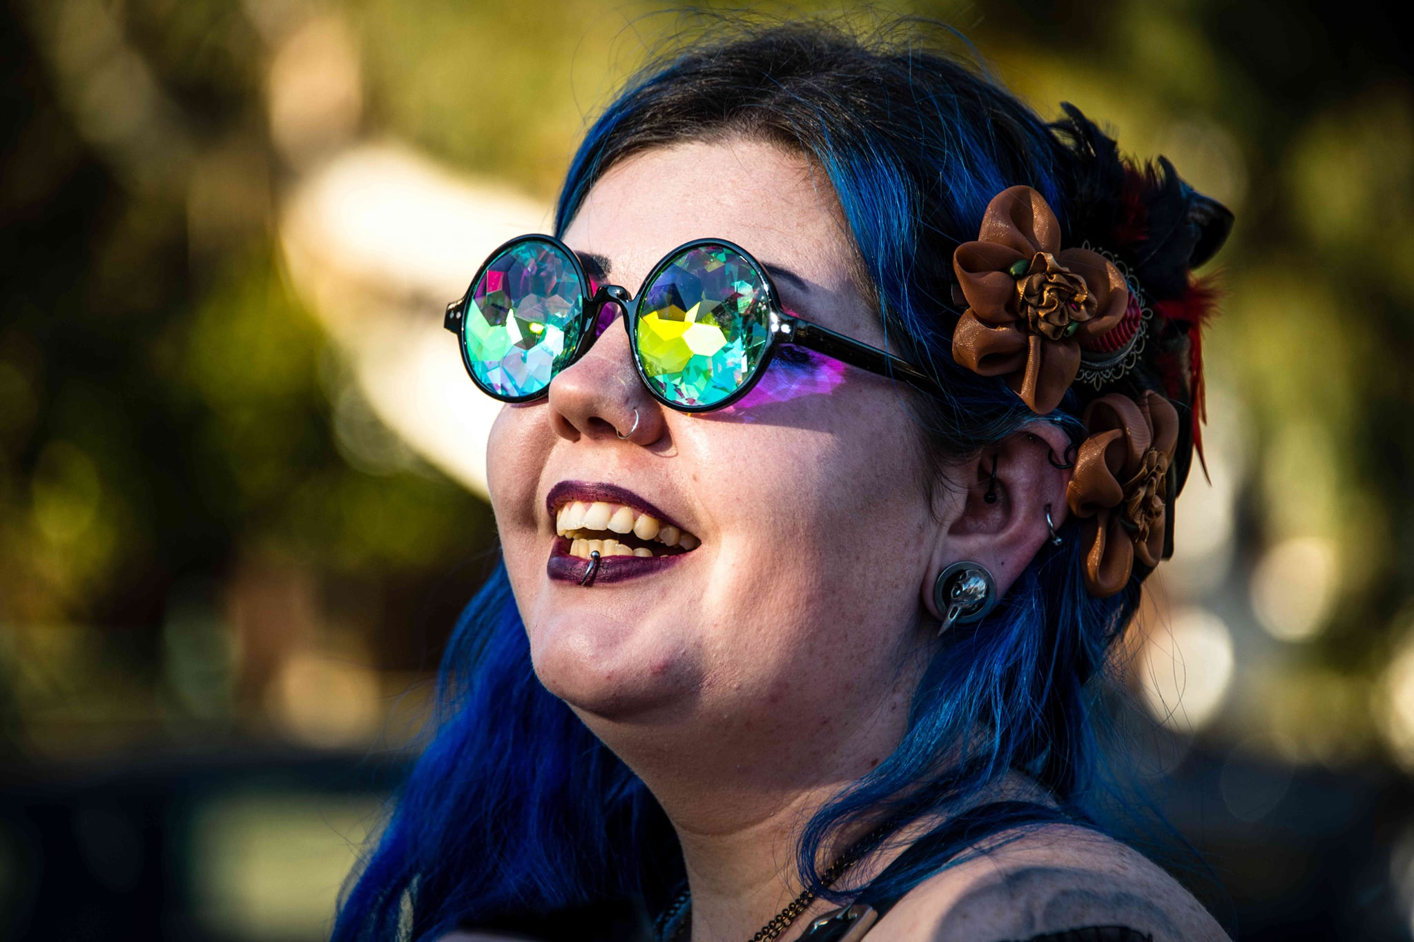
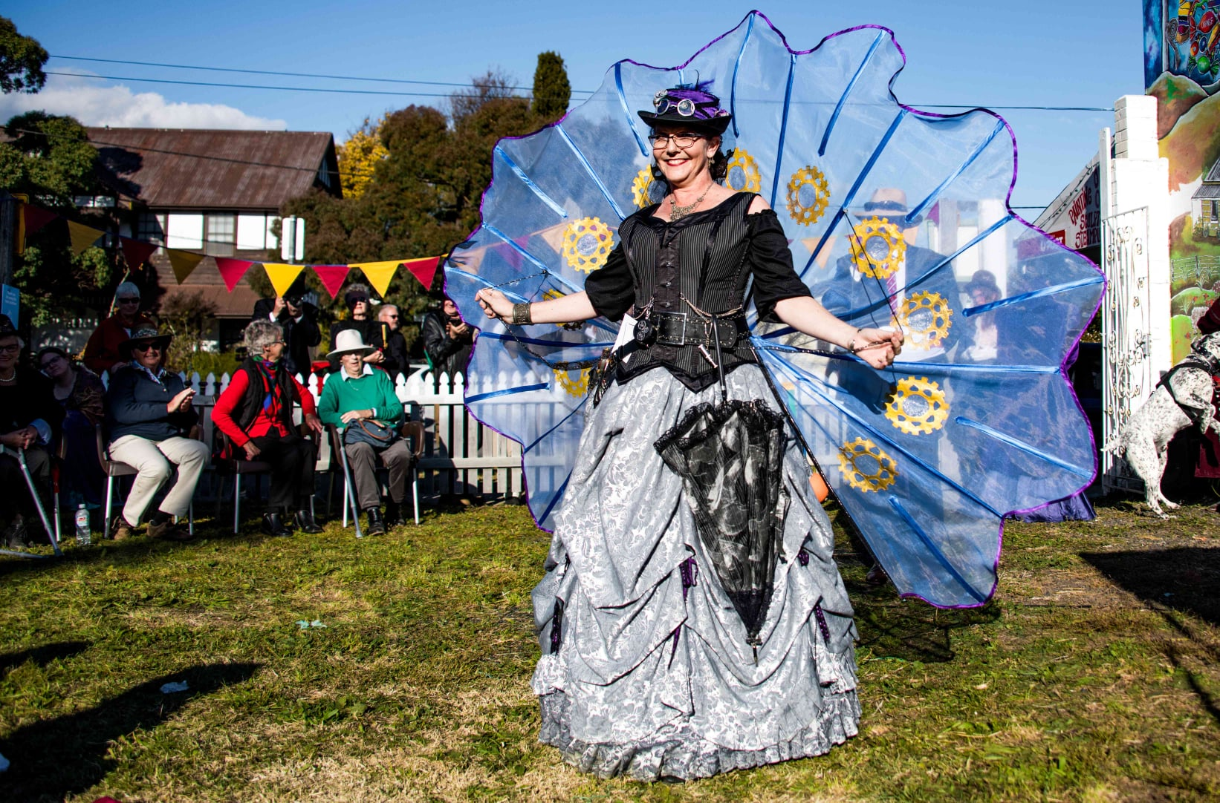
EVENTS
Across Australia
MAKERS & TRADERS
Support local creativity
CLUBS & COMMUNITIES
Find your people
ARTICLES & STORIES
News, features & inspiration

