Slide 1








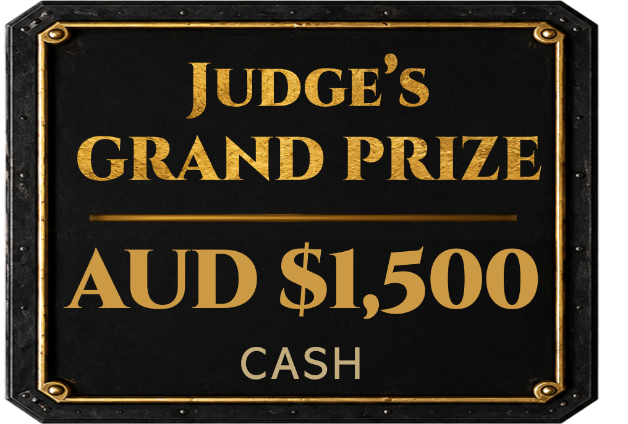
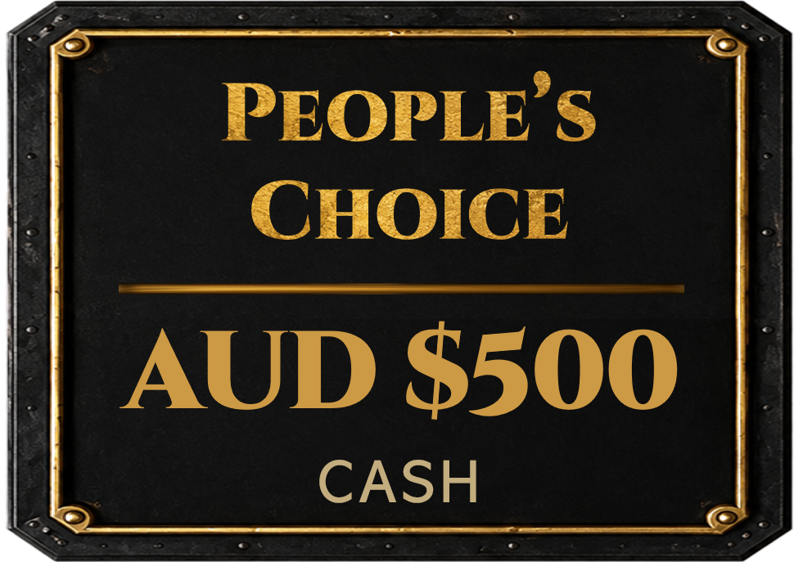

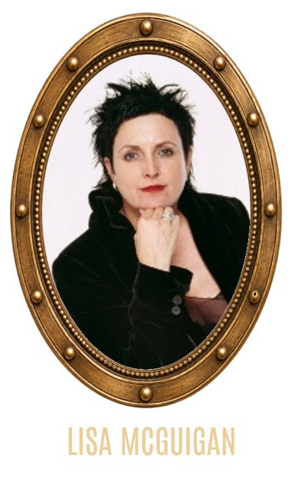
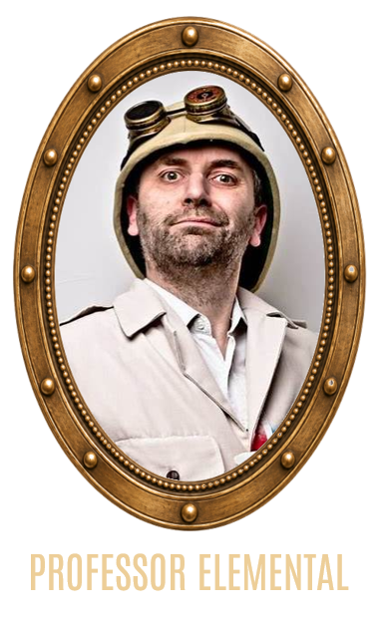
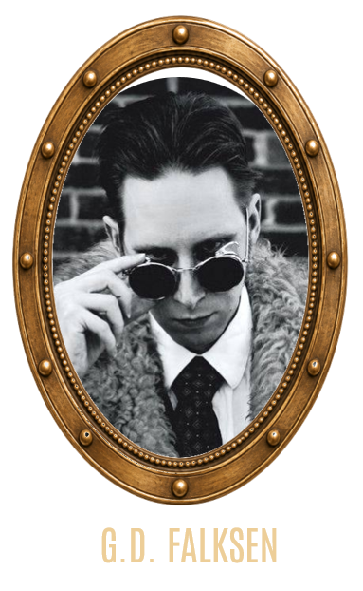
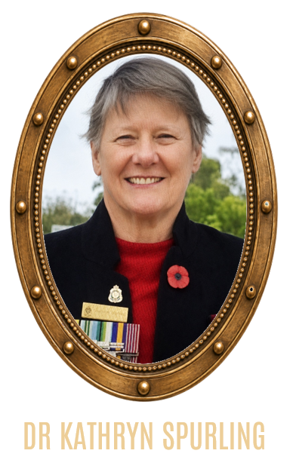

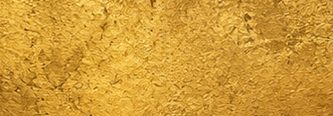
Art
competition
competition
MEET THE JUDGES
OPEN TO ARTISTS
WORLDWIDE
All ART FORMS
WELCOME
OPEN NOW!
ENTRIES CLOSE
30 NOV 2026
FROM EVERYWHERE
FOR EVERYWHERE
PAINTING ⚙ DRAWING ⚙ SCULPTURE ⚙ PHOTOGRAPHY ⚙ DIGITAL ART ⚙ MIXED MEDIA ⚙ COSTUME DESIGN ⚙ & MORE
JUDGES' GRAND PRIZE
PEOPLE’S CHOICE
AUD $1,500 CASH
AUD $500 CASH

Slide 2
Art
competition
competition
MEET THE JUDGES
OPEN NOW!
ENTRIES CLOSE
30 NOV 2026
PAINTING ⚙ DRAWING ⚙ SCULPTURE ⚙ PHOTOGRAPHY ⚙ DIGITAL ART ⚙ MIXED MEDIA ⚙ COSTUME DESIGN ⚙ & MORE

Slide 3
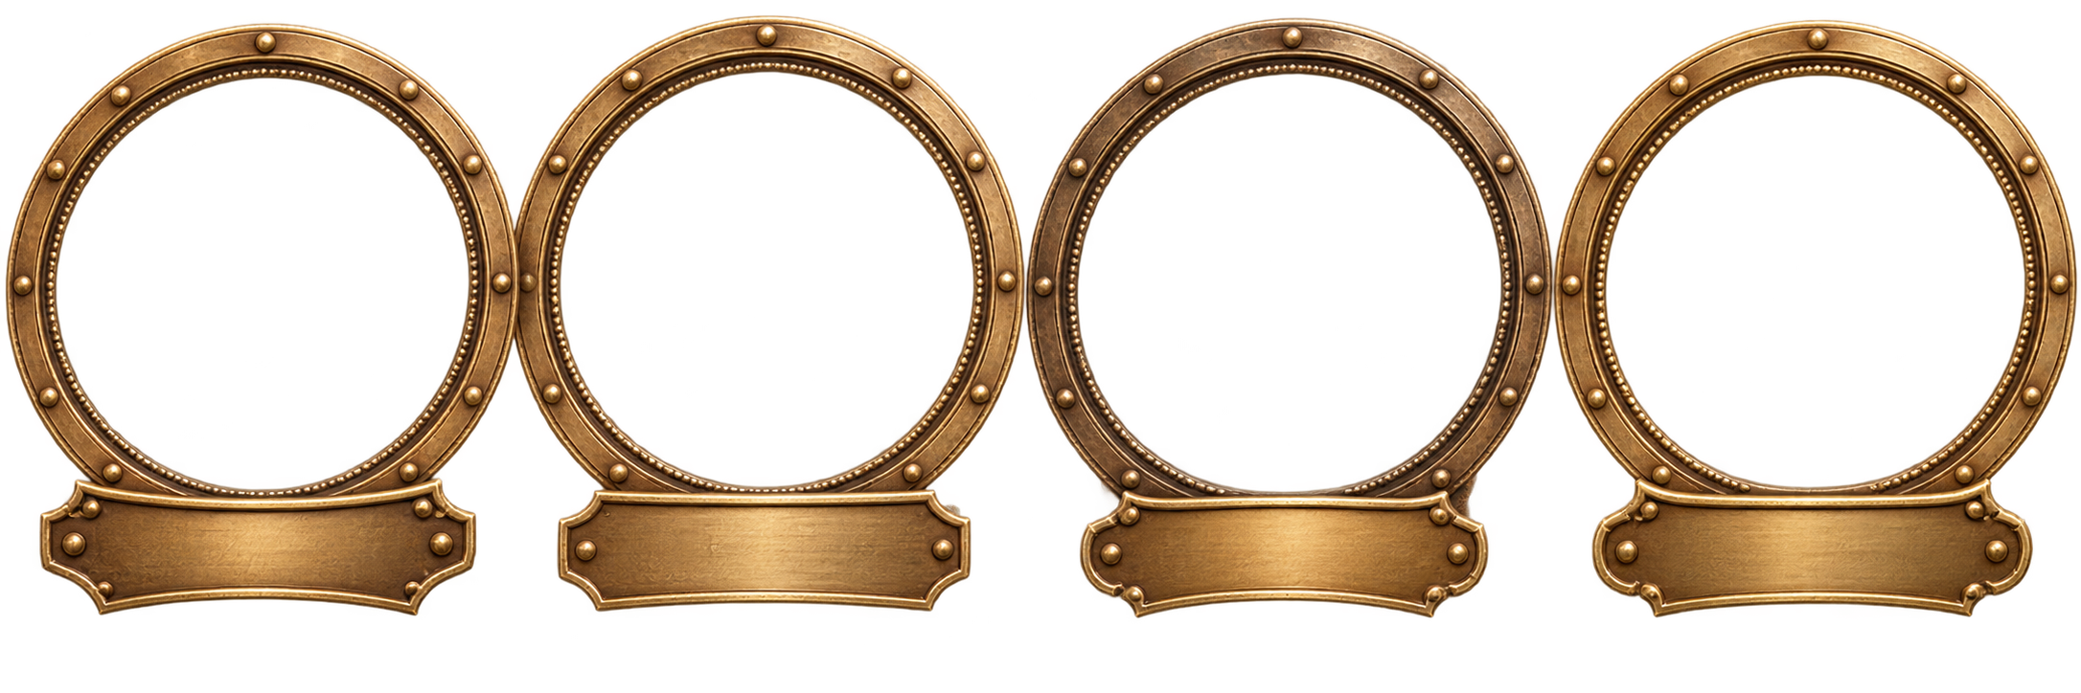
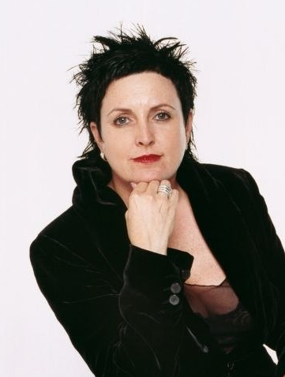
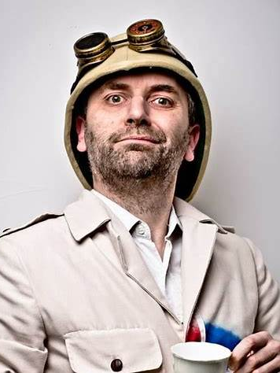
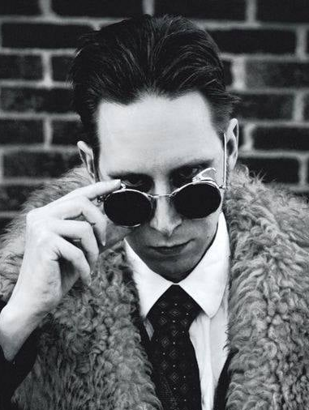
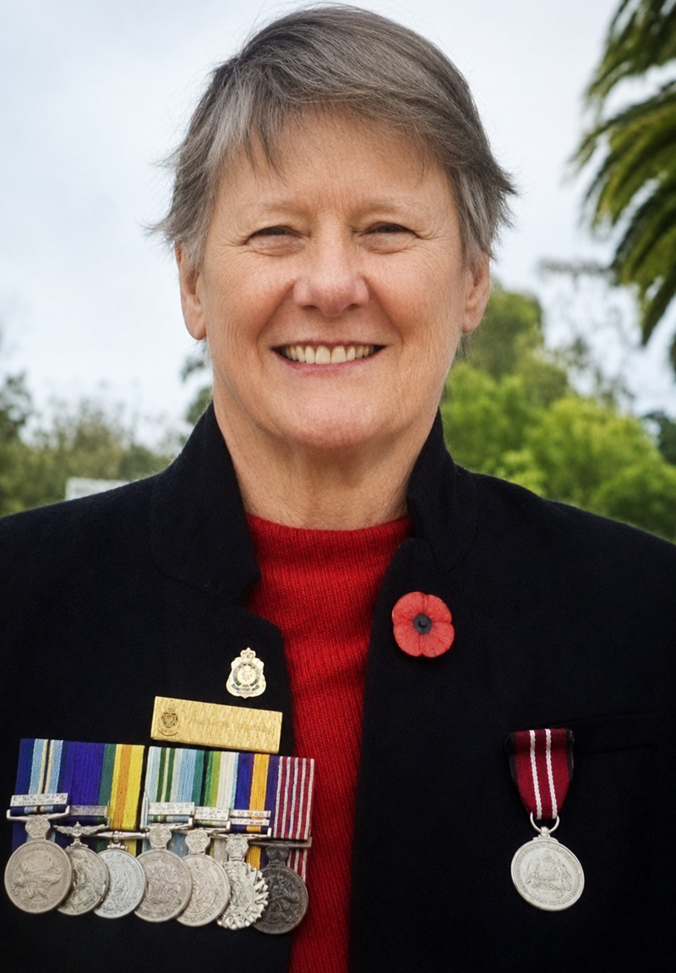

AUD $500
CASH
STEAMPUNK.AU
Art
competition
competition
FROM EVERYWHERE
FOR EVERYWHERE
PAINTING ⚙ DRAWING ⚙ SCULPTURE ⚙ PHOTOGRAPHY ⚙ DIGITAL ART ⚙ MIXED MEDIA ⚙ COSTUME DESIGN ⚙ & MORE
JUDGES' GRAND PRIZE
PEOPLE’S CHOICE
AUD $1,500 CASH
AUD $500 CASH
People’s
Choice
AUD $500
CASH

Slide 4

LISA MCGUIGAN
PROFESSOR ELEMENTAL
G.D. FALKSEN
DR KATHRYN SPURLING

Slide 6

STEAMPUNK AUSTRALIA PRESENTS
THE INTERNET IS TELLING US
THE ART WORLD
IS BEING INVADED BY BOTS.
FROM EVERYWHERE
FOR EVERYWHERE
OPEN TO ARTISTS
WORLDWIDE
All ART FORMS
WELCOME
We’re opening the competition to the world
so human imagination can prove otherwise.
JUDGES' GRAND PRIZE
AUD $1,500 CASH
PAINTING ⚙ DRAWING ⚙ SCULPTURE ⚙ PHOTOGRAPHY ⚙ DIGITAL ART ⚙ MIXED MEDIA ⚙ COSTUME DESIGN ⚙ & MORE

Slide 7
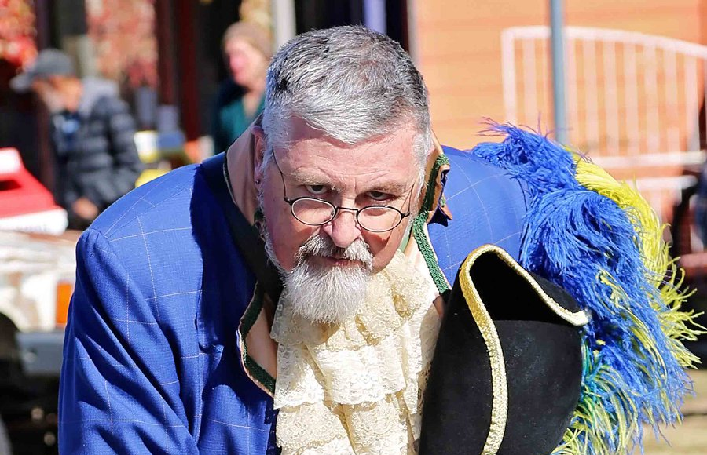
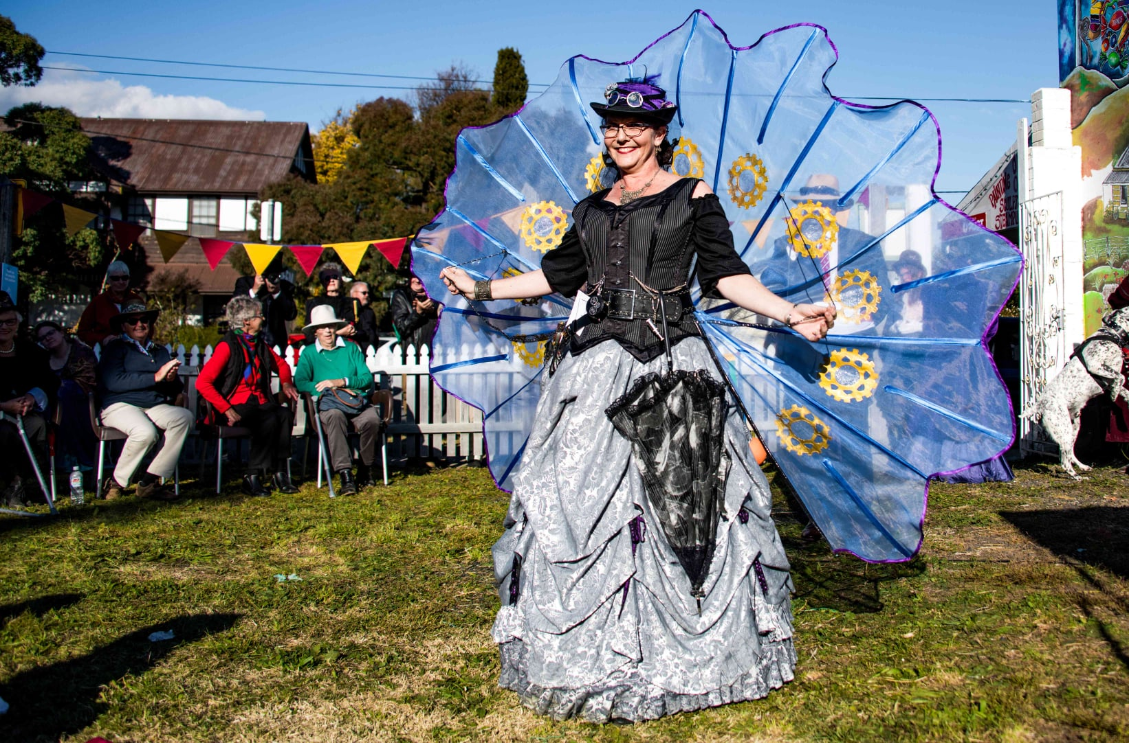
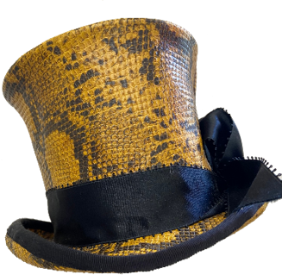
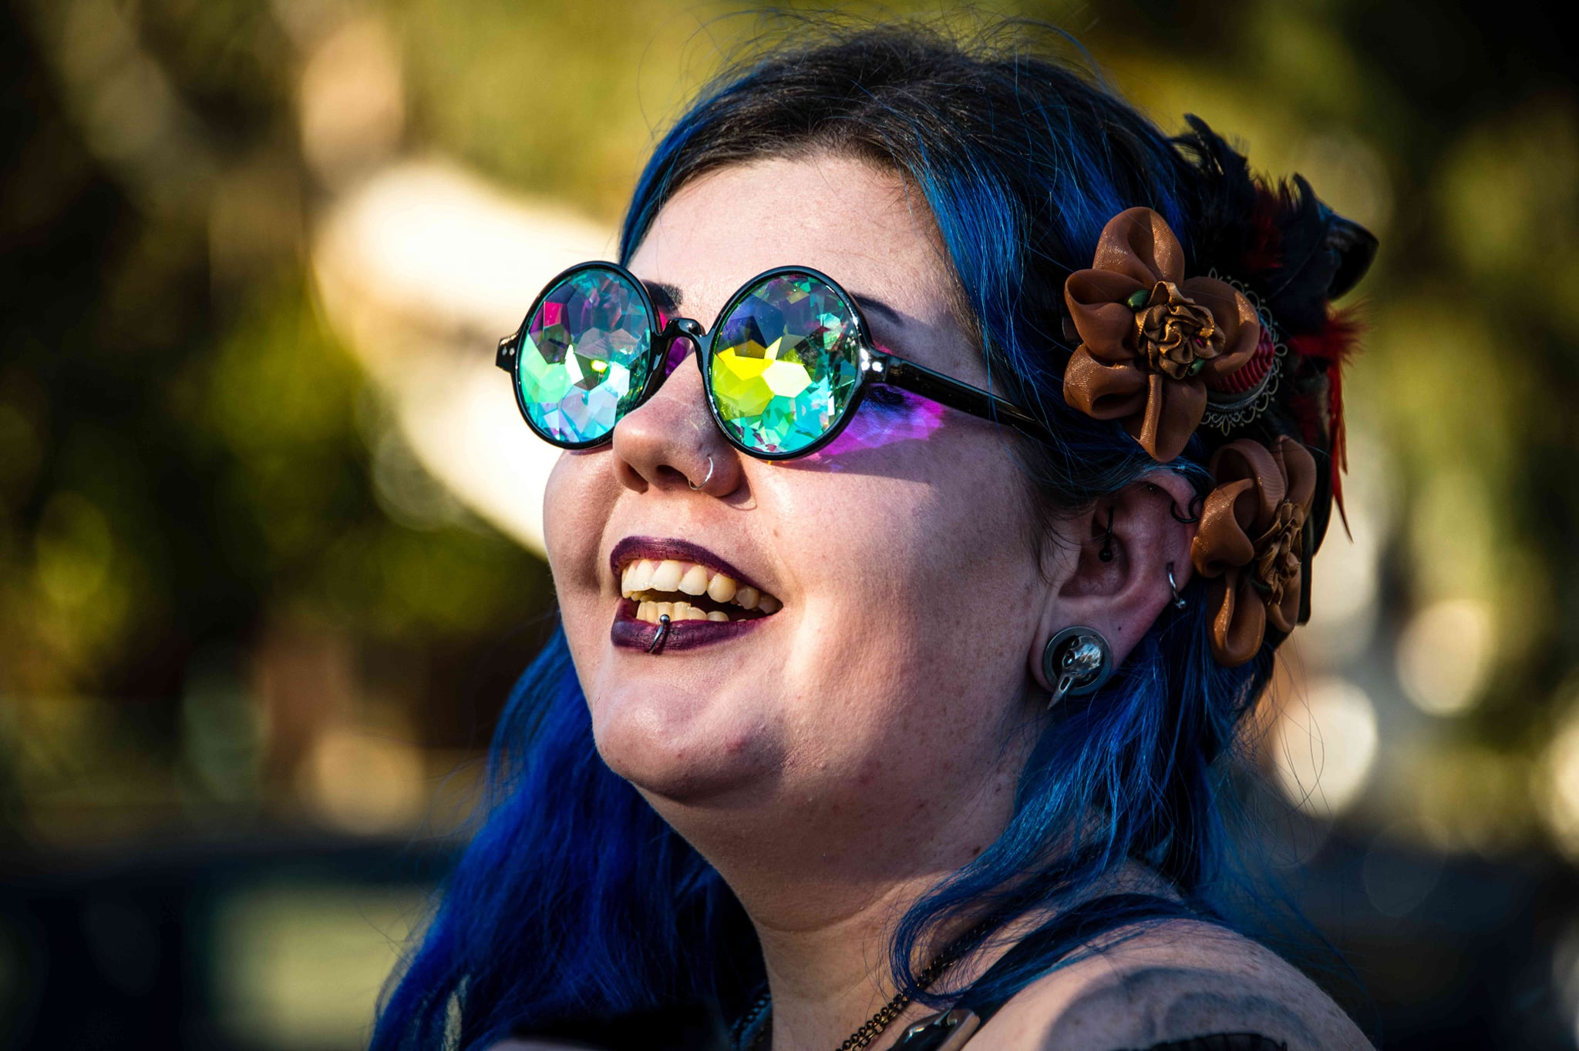

EVENTS
MAKERS & TRADERS
CLUBS & COMMUNITIES
ARTICLES & STORIES

Slide 8
EVENTS
MAKERS & TRADERS
CLUBS & COMMUNITIES
ARTICLES & STORIES

Slide 9
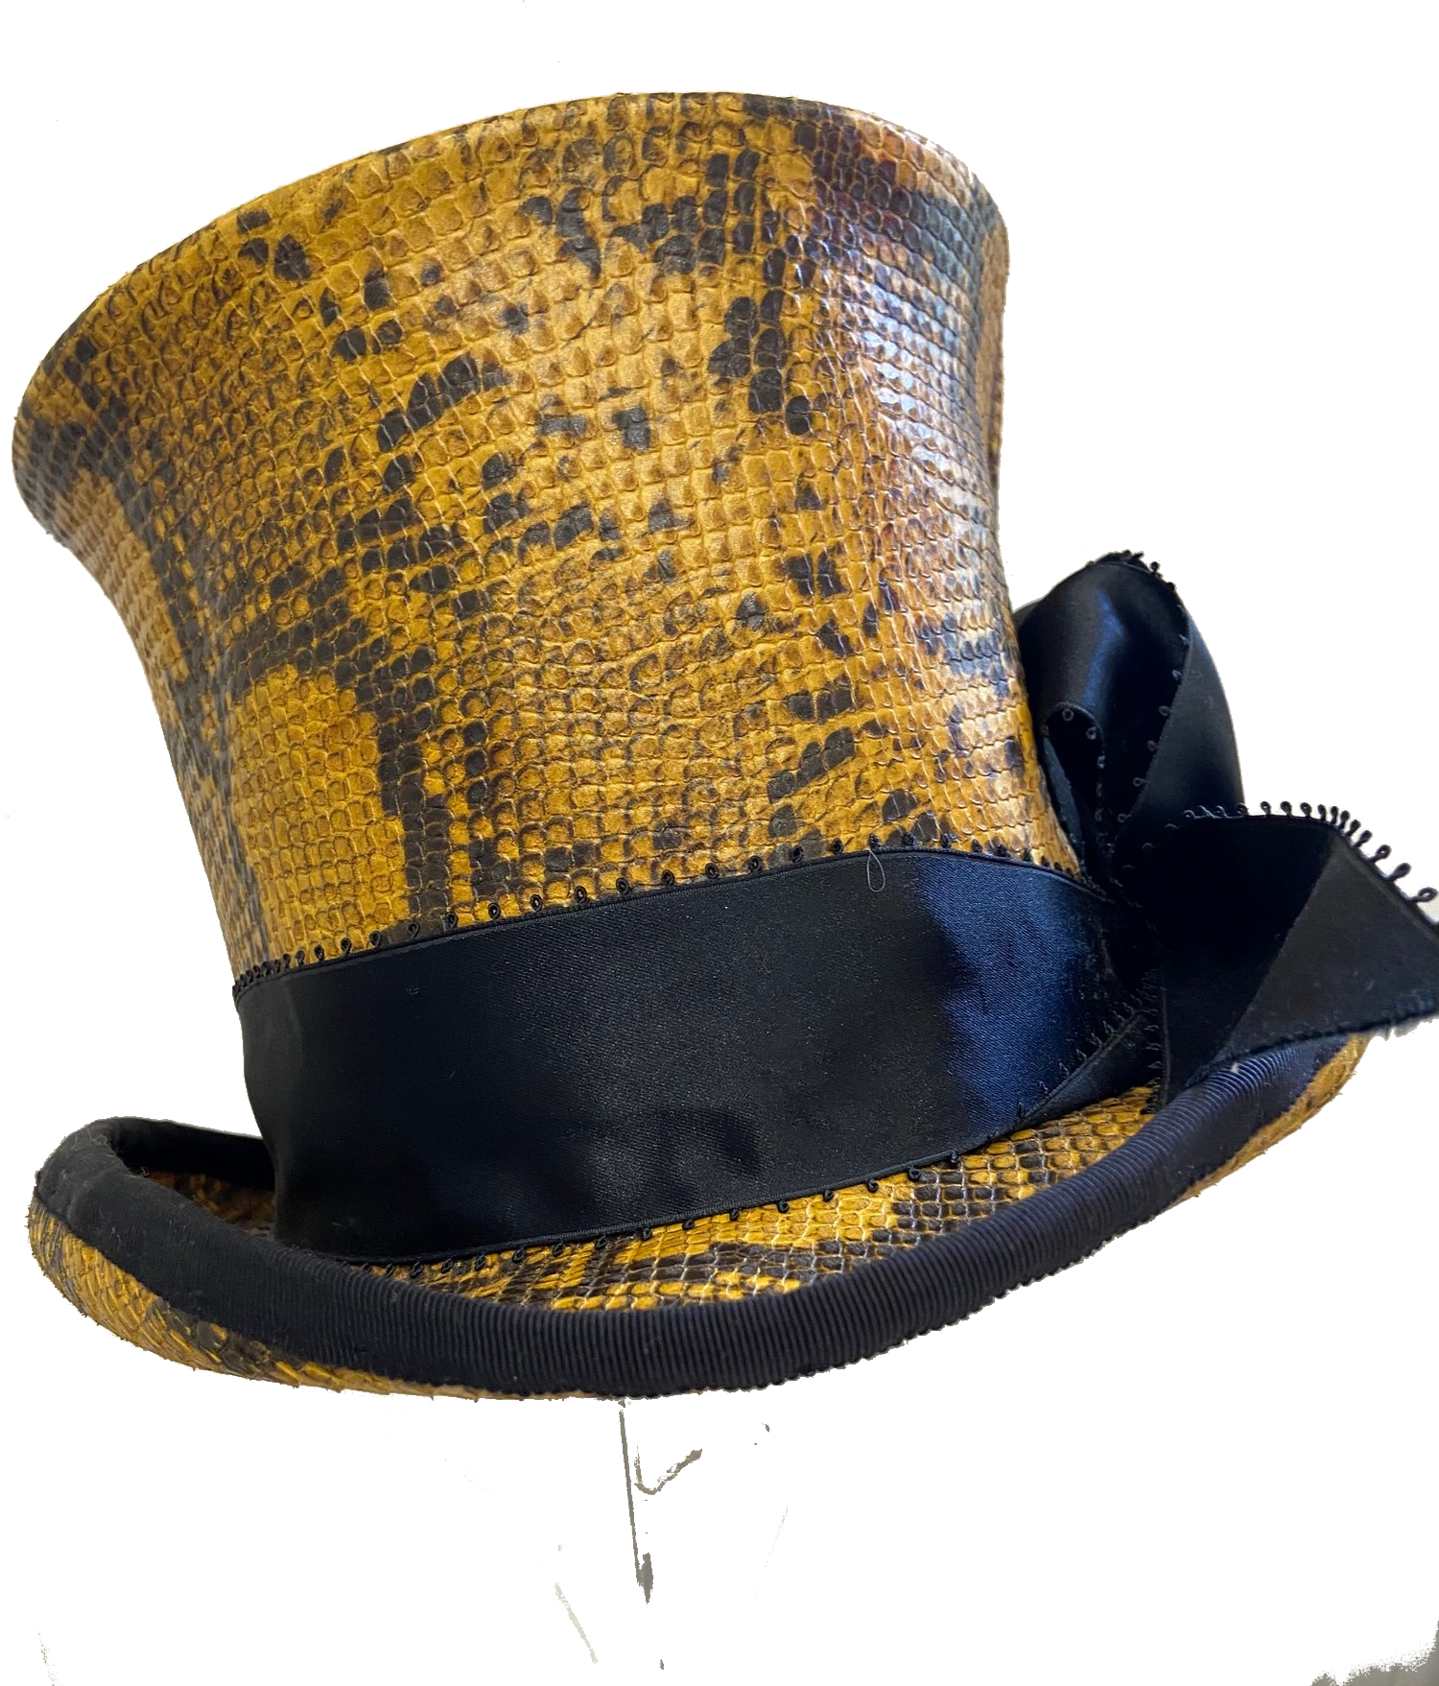
EVENTS
Across Australia
MAKERS & TRADERS
Support local creativity
CLUBS & COMMUNITIES
Find your people
ARTICLES & STORIES
News, features & inspiration

Slide 10
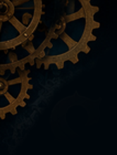





EVENTS
MAKERS & TRADERS
CLUBS & COMMUNITIES
ARTICLES & STORIES

